Slide 1
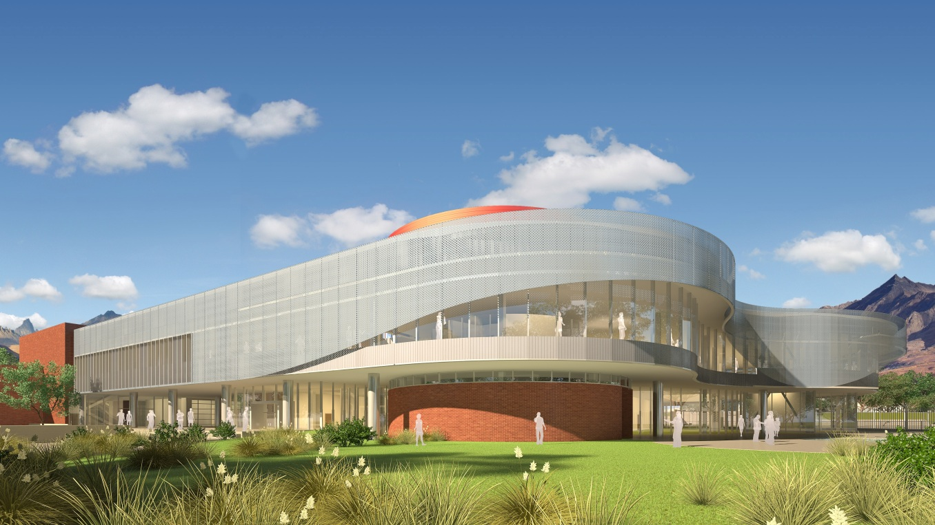
Senior Thesis Final Presentation
University of California, Riverside Student Recreation Center
Daniel MacRitchie
04/10/2013

Slide 2
Introduction
Entrance
Lobby
Daylighting Analysis
Photovoltaic Analysis
Structural Analysis
Conclusion

Slide 3
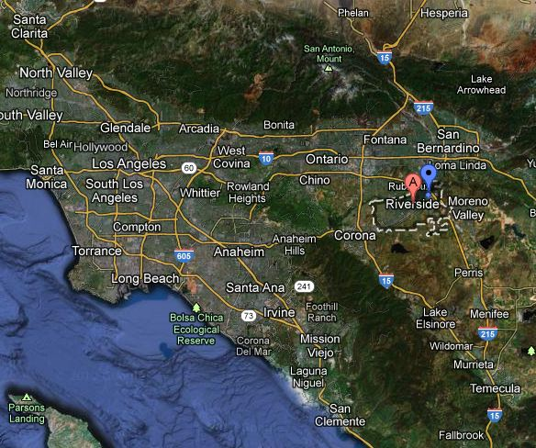
Introduction
Entrance
Lobby
Daylighting Analysis
Photovoltaic Analysis
Structural Analysis
Conclusion
N

Slide 4
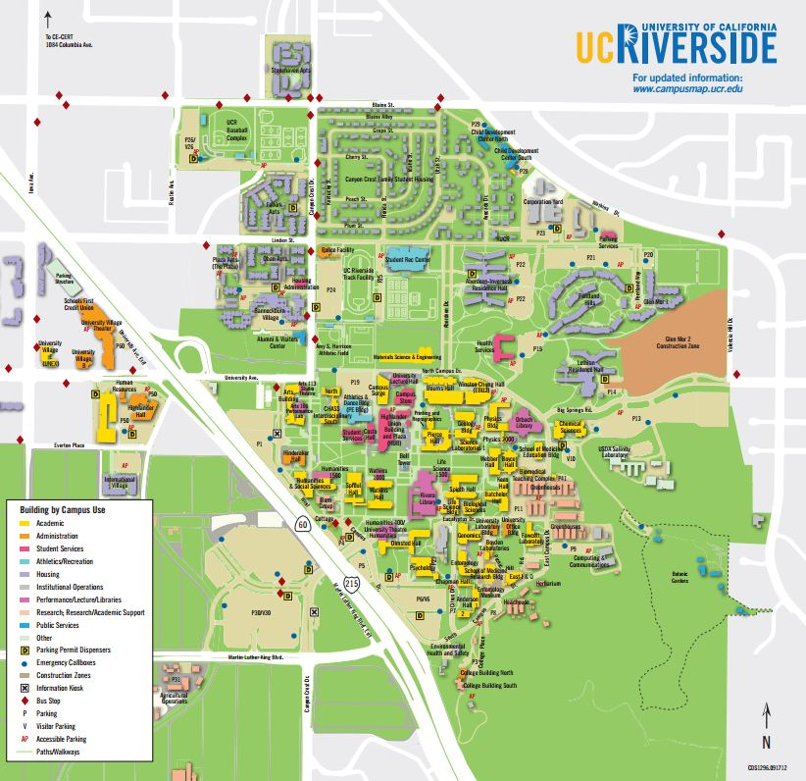
Introduction
Entrance
Lobby
Daylighting Analysis
Photovoltaic Analysis
Structural Analysis
Conclusion
N

Slide 5
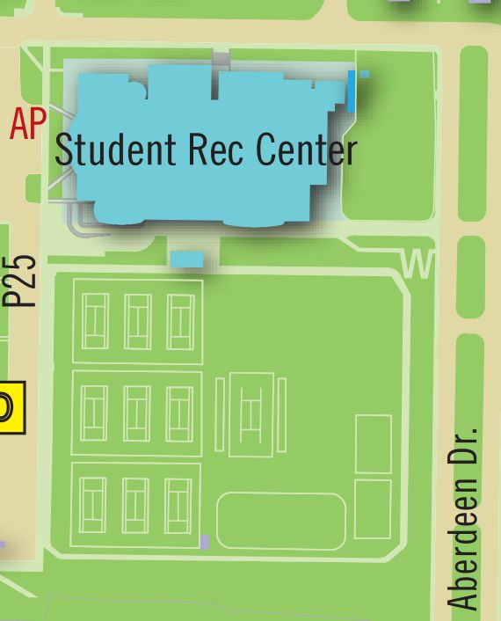

Building Information
Location: Riverside, CA
Renovation: 16,000 SF
Expansion: 80,000 SF
Stories: Two
Building Cost: $36.9 Million
Building Function
Renovate exercise areas to offices
Gymnasium
Multipurpose rooms
Weight rooms
Exercise rooms
Rock climbing wall
Outdoor pool
Classrooms
Spa
Massage therapy rooms
Introduction
Entrance
Lobby
Daylighting Analysis
Photovoltaic Analysis
Structural Analysis
Conclusion
N

Slide 6
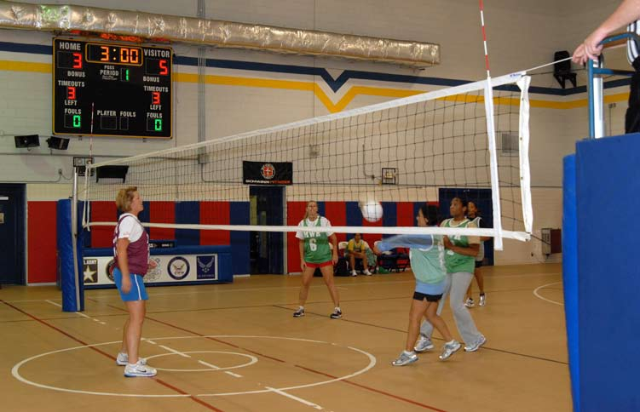


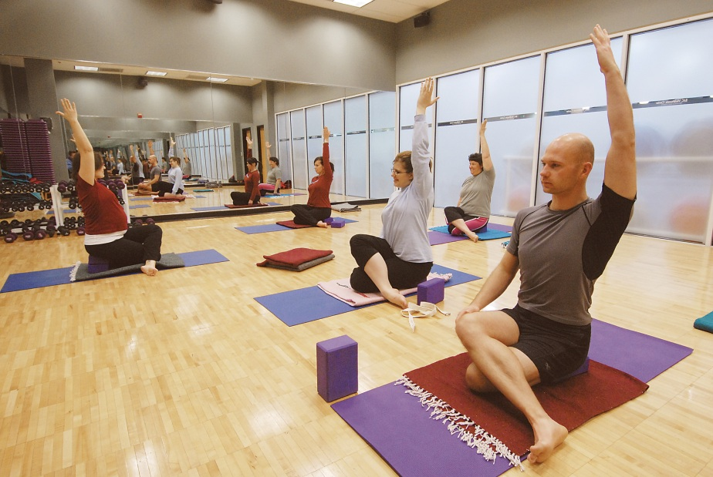
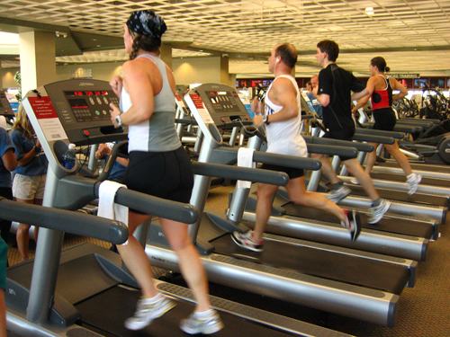


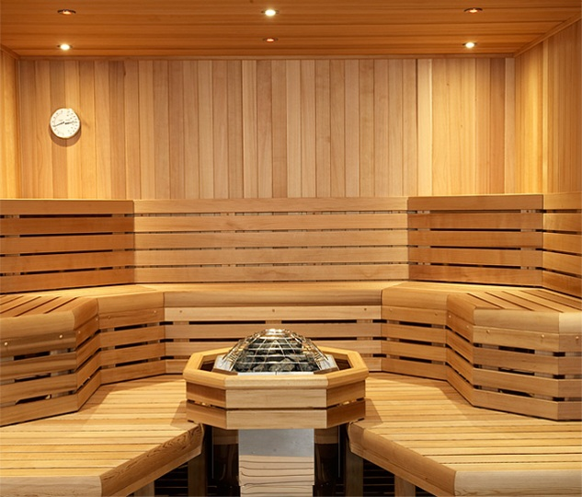
Introduction
Entrance
Lobby
Daylighting Analysis
Photovoltaic Analysis
Structural Analysis
Conclusion

Slide 7
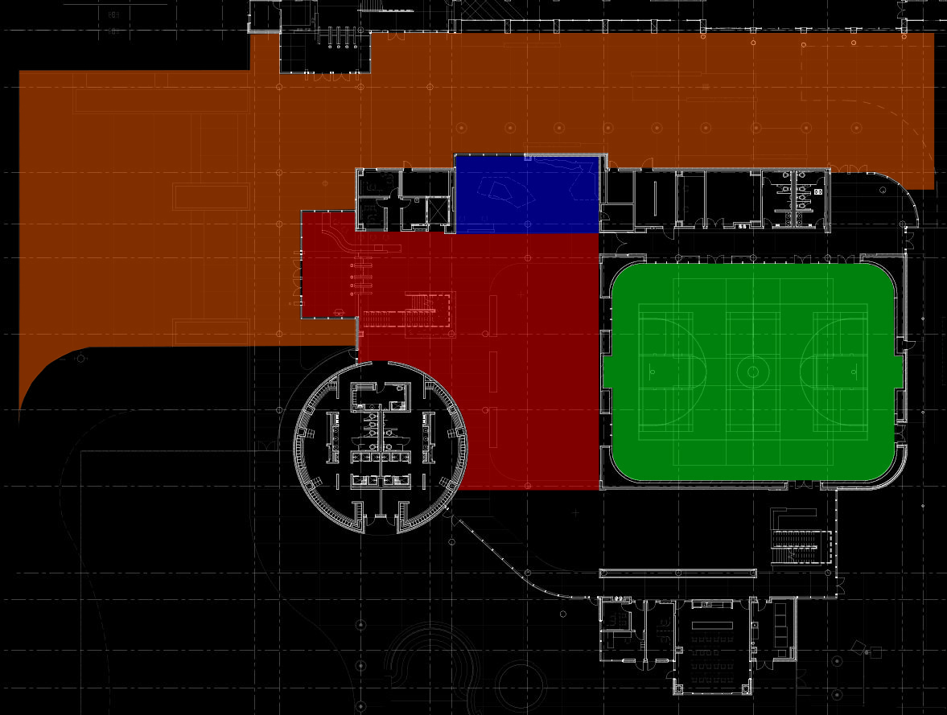
Introduction
Entrance
Lobby
Daylighting Analysis
Photovoltaic Analysis
Structural Analysis
Conclusion
Entrance
Lobby
Rock Wall
Gymnasium
N

Slide 8
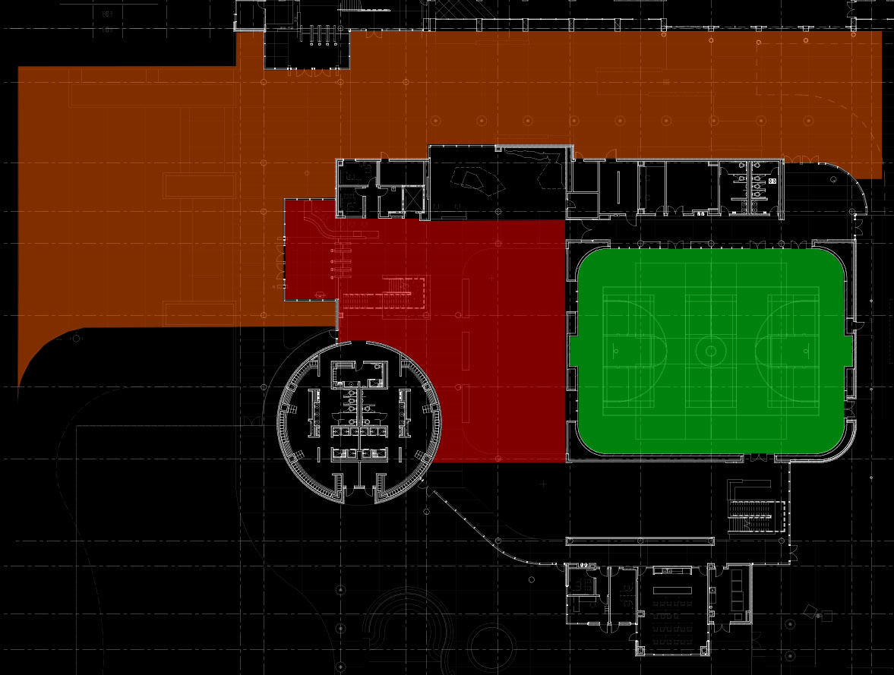
Introduction
Entrance
Lobby
Daylighting Analysis
Photovoltaic Analysis
Structural Analysis
Conclusion
Entrance
Lobby
Gymnasium
N

Slide 9
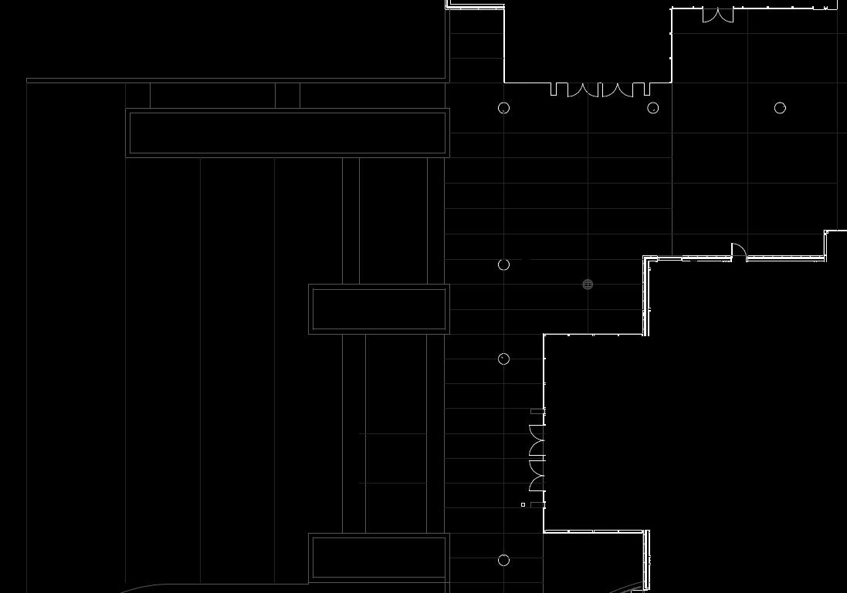
Introduction
Entrance
Lobby
Daylighting Analysis
Photovoltaic Analysis
Structural Analysis
Conclusion
Space | Target E_{avg} | Target E_{avg}:E_{min}
Stairs | 4 lux | 5
Entrance | 15 lux | 2
Courtyard | 3 lux | 5
Space | ASHRAE 90.1 2010 Allowable Watts | Title 24 Allowable Watts
Tradable | 5,473 | 3,622
Non-tradable | 193 | 178
N

Slide 10
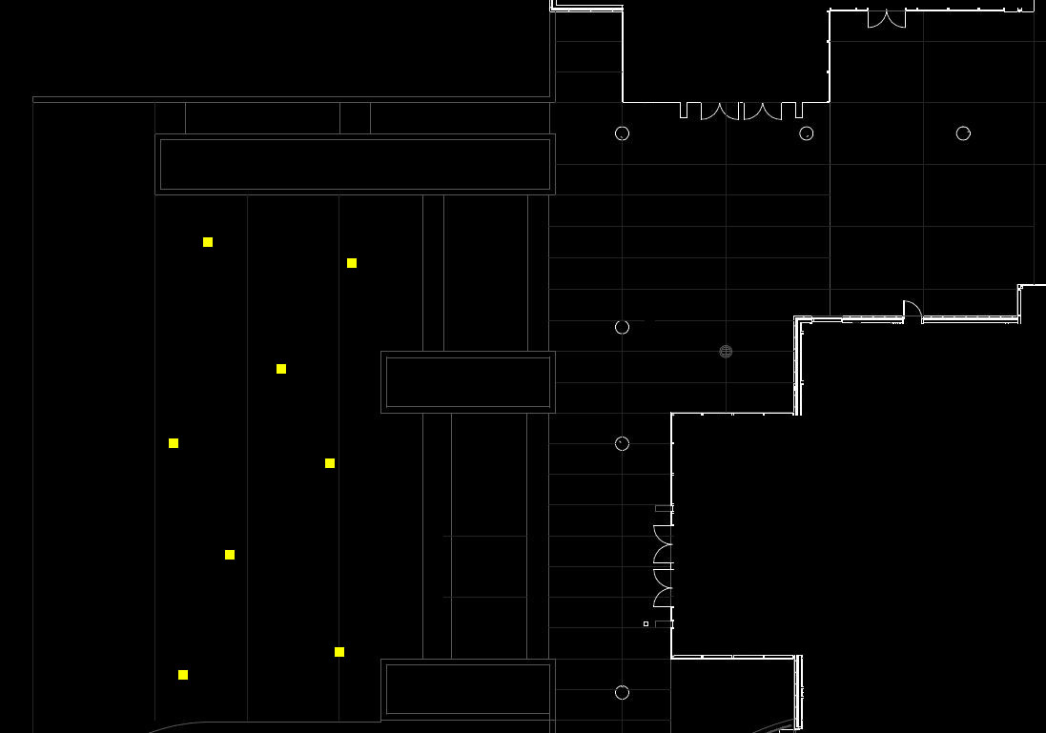
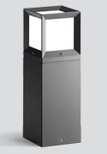
Introduction
Entrance
Lobby
Daylighting Analysis
Photovoltaic Analysis
Structural Analysis
Conclusion
Space | Target E_{avg} | Target E_{avg}:E_{min}
Stairs | 4 lux | 5
Entrance | 15 lux | 2
Courtyard | 3 lux | 5
Space | ASHRAE 90.1 2010 Allowable Watts | Title 24 Allowable Watts
Tradable | 5,473 | 3,622
Non-tradable | 193 | 178
N

Slide 11
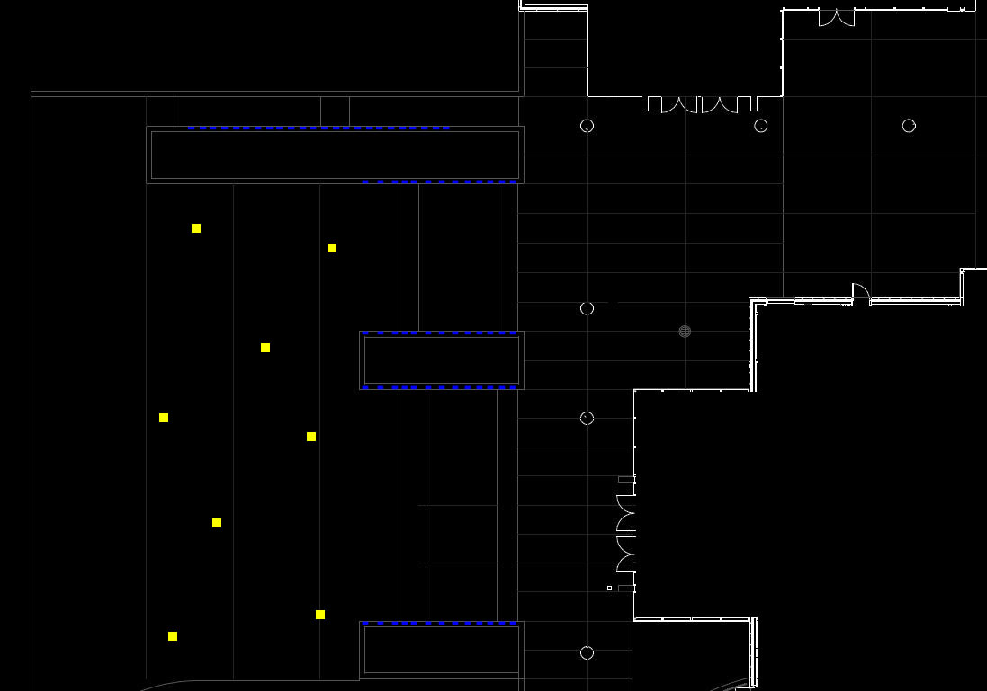

Introduction
Entrance
Lobby
Daylighting Analysis
Photovoltaic Analysis
Structural Analysis
Conclusion
Space | Target E_{avg} | Target E_{avg}:E_{min}
Stairs | 4 lux | 5
Entrance | 15 lux | 2
Courtyard | 3 lux | 5
Space | ASHRAE 90.1 2010 Allowable Watts | Title 24 Allowable Watts
Tradable | 5,473 | 3,622
Non-tradable | 193 | 178
N

Slide 12
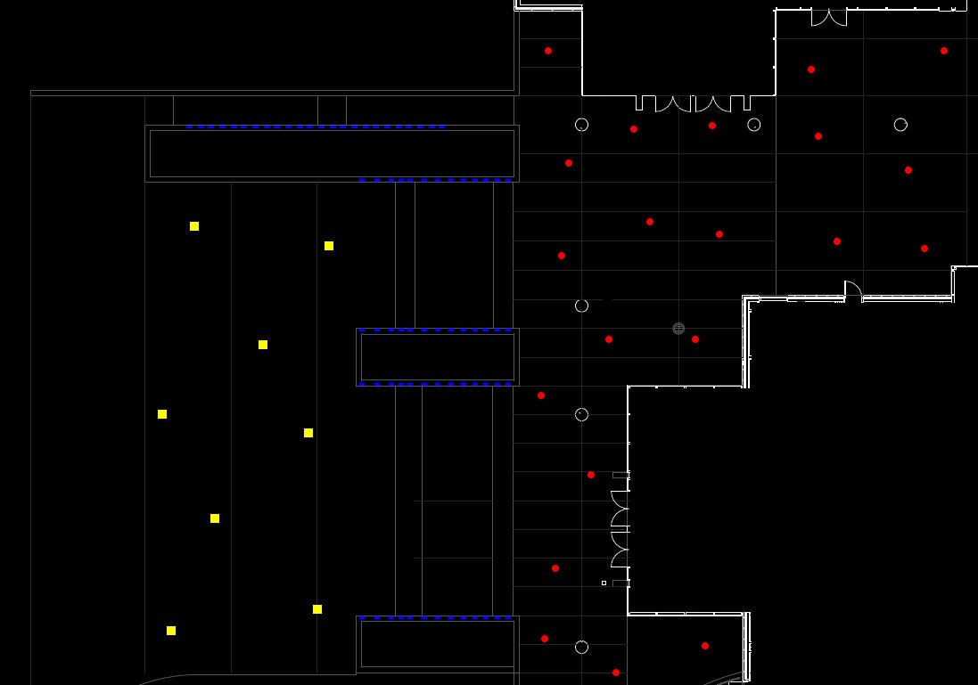

Introduction
Entrance
Lobby
Daylighting Analysis
Photovoltaic Analysis
Structural Analysis
Conclusion
Space | Target E_{avg} | Target E_{avg}:E_{min}
Stairs | 4 lux | 5
Entrance | 15 lux | 2
Courtyard | 3 lux | 5
Space | ASHRAE 90.1 2010 Allowable Watts | Title 24 Allowable Watts
Tradable | 5,473 | 3,622
Non-tradable | 193 | 178
N

Slide 13
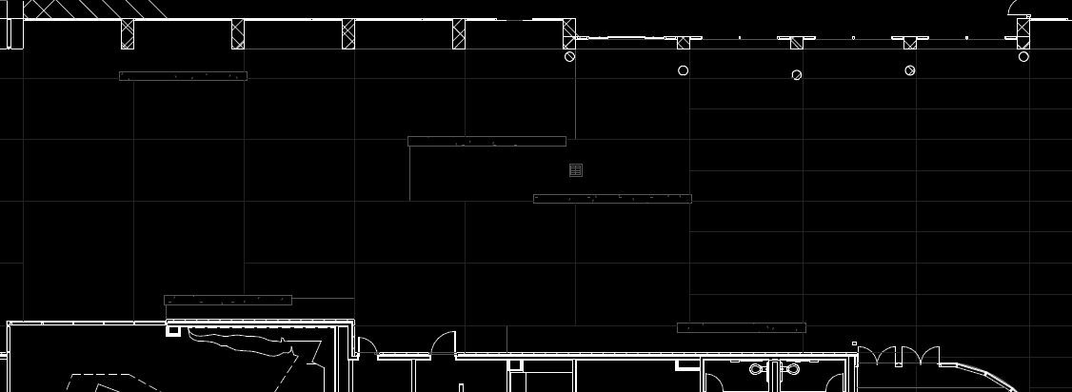
Introduction
Entrance
Lobby
Daylighting Analysis
Photovoltaic Analysis
Structural Analysis
Conclusion
Space | Target E_{avg} | Target E_{avg}:E_{min}
Stairs | 4 lux | 5
Entrance | 15 lux | 2
Courtyard | 3 lux | 5
Space | ASHRAE 90.1 2010 Allowable Watts | Title 24 Allowable Watts
Tradable | 5,473 | 3,622
Non-tradable | 193 | 178
N

Slide 14
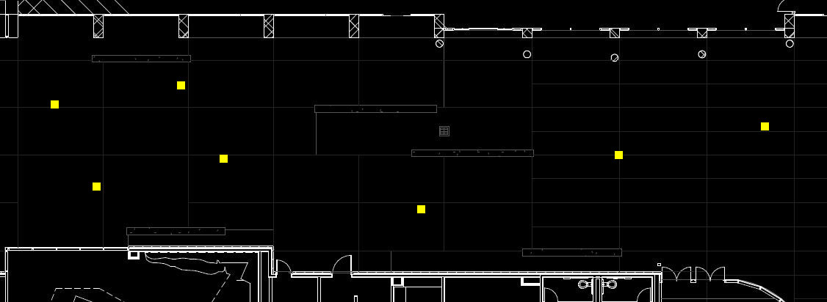
Introduction
Entrance
Lobby
Daylighting Analysis
Photovoltaic Analysis
Structural Analysis
Conclusion
Space | Target E_{avg} | Target E_{avg}:E_{min}
Stairs | 4 lux | 5
Entrance | 15 lux | 2
Courtyard | 3 lux | 5
Space | ASHRAE 90.1 2010 Allowable Watts | Title 24 Allowable Watts
Tradable | 5,473 | 3,622
Non-tradable | 193 | 178
N

Slide 15
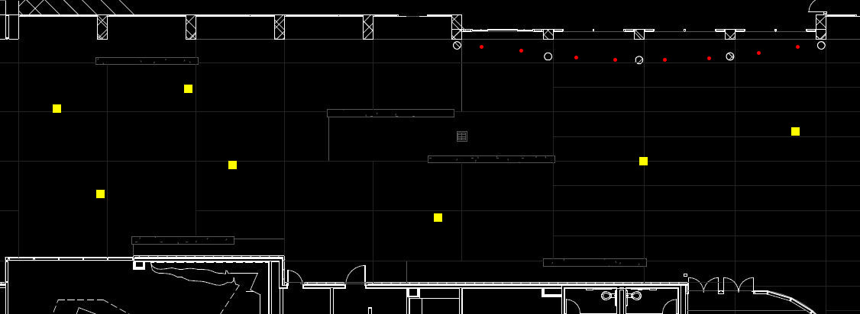
Introduction
Entrance
Lobby
Daylighting Analysis
Photovoltaic Analysis
Structural Analysis
Conclusion
Space | Target E_{avg} | Target E_{avg}:E_{min}
Stairs | 4 lux | 5
Entrance | 15 lux | 2
Courtyard | 3 lux | 5
Space | ASHRAE 90.1 2010 Allowable Watts | Title 24 Allowable Watts
Tradable | 5,473 | 3,622
Non-tradable | 193 | 178
N

Slide 16
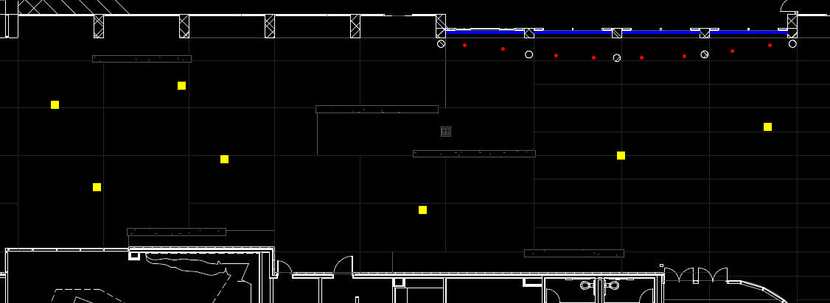

Introduction
Entrance
Lobby
Daylighting Analysis
Photovoltaic Analysis
Structural Analysis
Conclusion
Space | Target E_{avg} | Target E_{avg}:E_{min}
Stairs | 4 lux | 5
Entrance | 15 lux | 2
Courtyard | 3 lux | 5
Space | ASHRAE 90.1 2010 Allowable Watts | Title 24 Allowable Watts
Tradable | 5,473 | 3,622
Non-tradable | 193 | 178
N

Slide 17
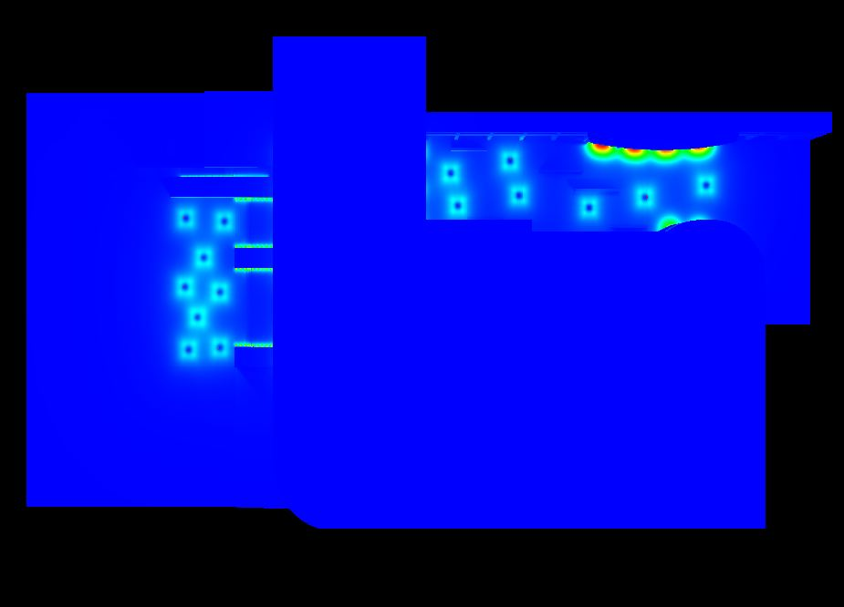
Introduction
Entrance
Lobby
Daylighting Analysis
Photovoltaic Analysis
Structural Analysis
Conclusion
Space | Target E_{avg} | Target E_{avg}:E_{min} | Design E_{avg} | Design E_{avg}:E_{min}
Stairs | 4 lux | 5 | 4.82 lux | 4.02
Entrance | 15 lux | 2 | 16.44 lux | 4.84
Courtyard | 3 lux | 5 | 5.04 lux | 5.60
Space | ASHRAE 90.1 2010 Allowable Watts | Title 24 Allowable Watts | Design Watts
Tradable | 5,473 | 3,622 | 1,160
Non-tradable | 193 | 178 | 410

Slide 18
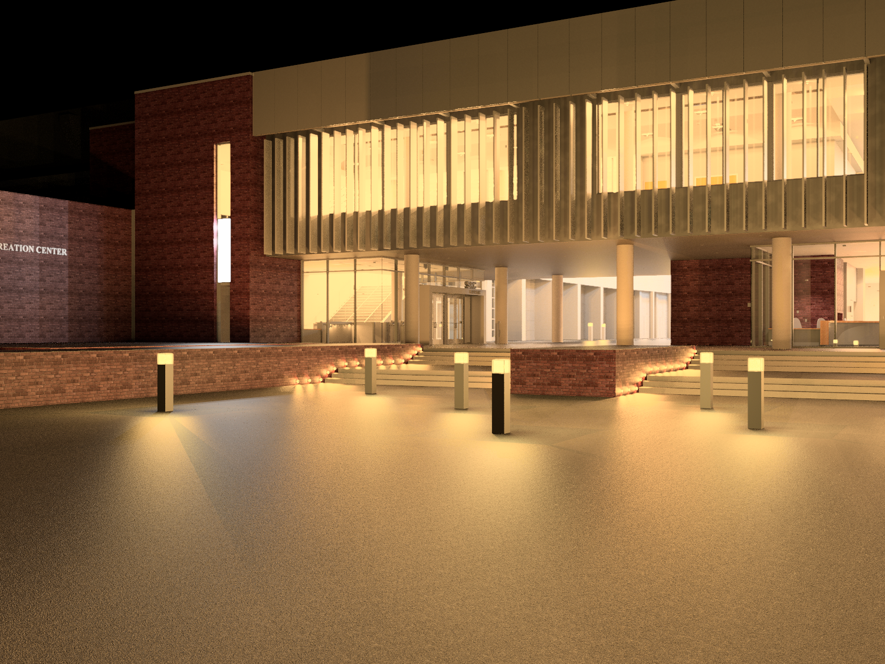
Introduction
Entrance
Lobby
Daylighting Analysis
Photovoltaic Analysis
Structural Analysis
Conclusion

Slide 19
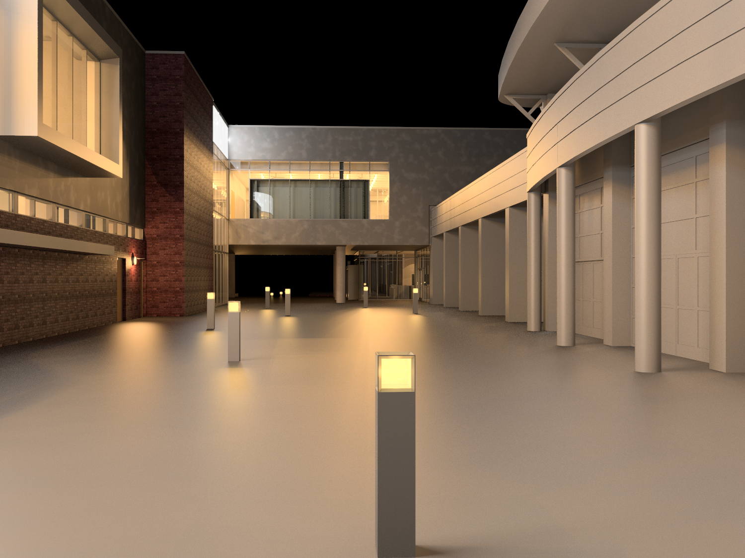
Introduction
Entrance
Lobby
Daylighting Analysis
Photovoltaic Analysis
Structural Analysis
Conclusion

Slide 20
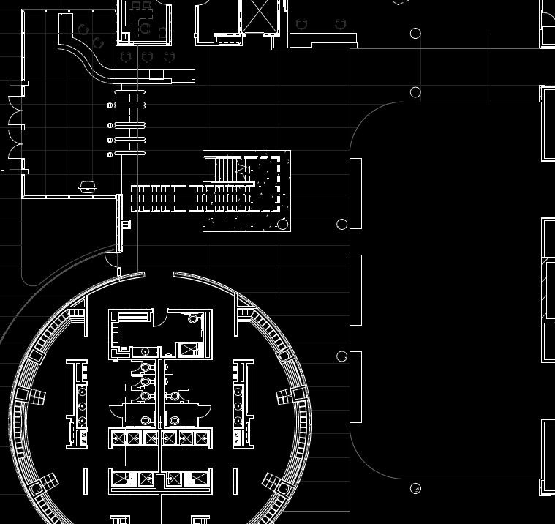
Introduction
Entrance
Lobby
Daylighting Analysis
Photovoltaic Analysis
Structural Analysis
Conclusion
Space | Target E_{avg} | Target E_{avg}:E_{min}
Lobby | 50 lux | 3
Transition | 45 lux | 2
Exercise Area | 150 lux | 3
Running Track | 150 lux | 3
Space | ASHRAE 90.1 2010 Allowable Watts | Title 24 Allowable Watts
Lobby | 10,504 | 9,236
N

Slide 21
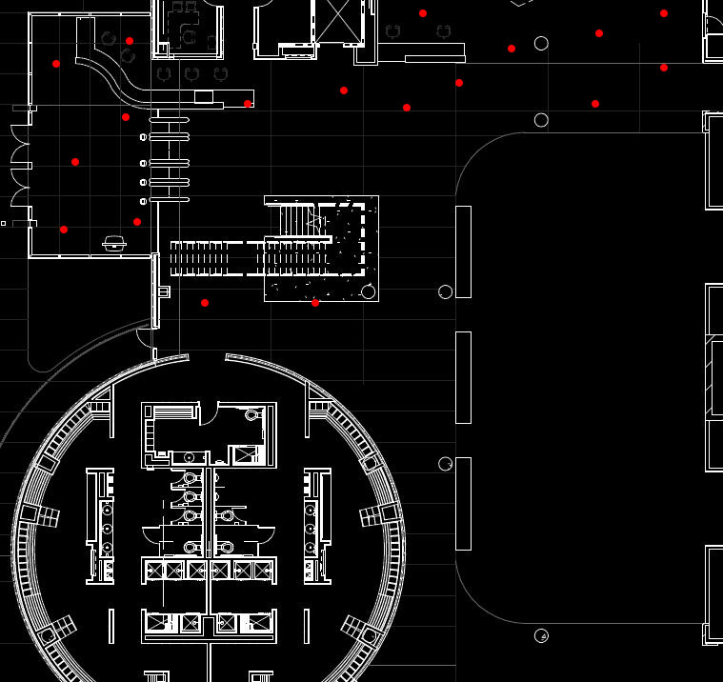
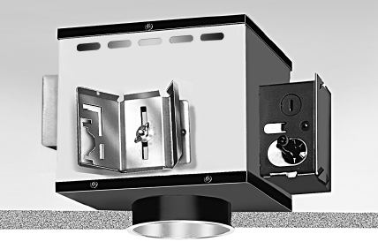
Introduction
Entrance
Lobby
Daylighting Analysis
Photovoltaic Analysis
Structural Analysis
Conclusion
Space | Target E_{avg} | Target E_{avg}:E_{min}
Lobby | 50 lux | 3
Transition | 45 lux | 2
Exercise Area | 150 lux | 3
Running Track | 150 lux | 3
Space | ASHRAE 90.1 2010 Allowable Watts | Title 24 Allowable Watts
Lobby | 10,504 | 9,236
N

Slide 22
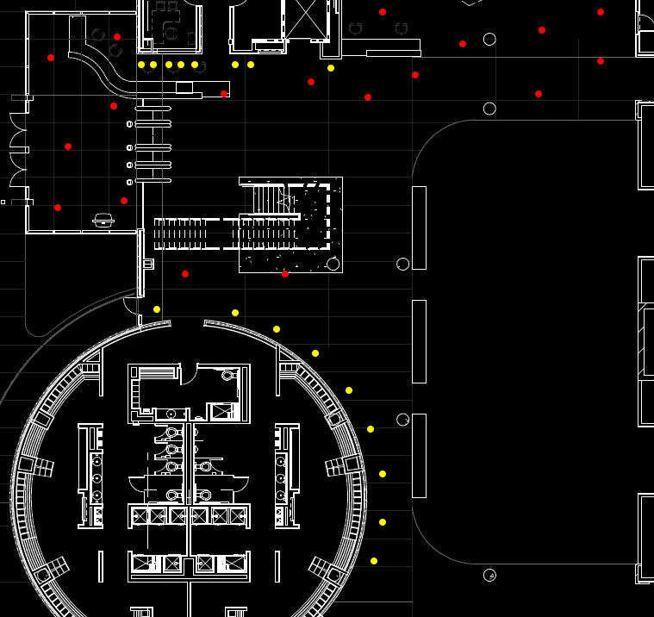
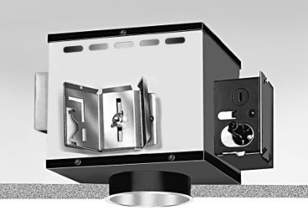
Introduction
Entrance
Lobby
Daylighting Analysis
Photovoltaic Analysis
Structural Analysis
Conclusion
Space | Target E_{avg} | Target E_{avg}:E_{min}
Lobby | 50 lux | 3
Transition | 45 lux | 2
Exercise Area | 150 lux | 3
Running Track | 150 lux | 3
Space | ASHRAE 90.1 2010 Allowable Watts | Title 24 Allowable Watts
Lobby | 10,504 | 9,236
N

Slide 23
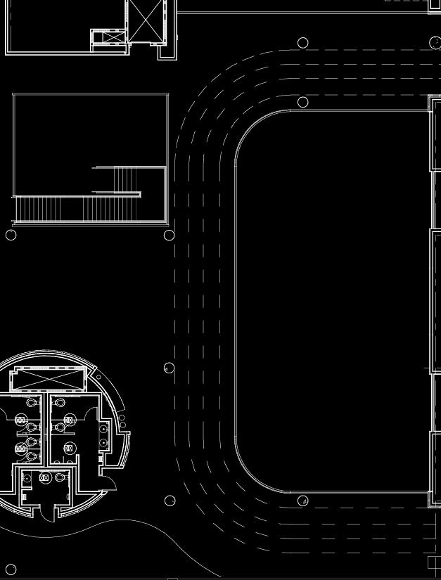
Introduction
Entrance
Lobby
Daylighting Analysis
Photovoltaic Analysis
Structural Analysis
Conclusion
Space | Target E_{avg} | Target E_{avg}:E_{min}
Lobby | 50 lux | 3
Transition | 45 lux | 2
Exercise Area | 150 lux | 3
Running Track | 150 lux | 3
Space | ASHRAE 90.1 2010 Allowable Watts | Title 24 Allowable Watts
Lobby | 10,504 | 9,236
N

Slide 24
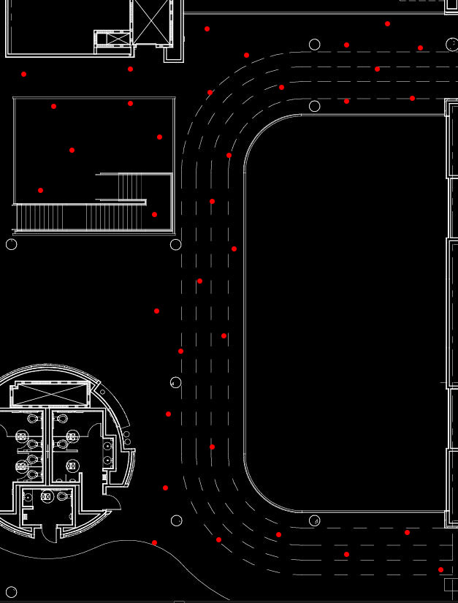
Introduction
Entrance
Lobby
Daylighting Analysis
Photovoltaic Analysis
Structural Analysis
Conclusion
Space | Target E_{avg} | Target E_{avg}:E_{min}
Lobby | 50 lux | 3
Transition | 45 lux | 2
Exercise Area | 150 lux | 3
Running Track | 150 lux | 3
Space | ASHRAE 90.1 2010 Allowable Watts | Title 24 Allowable Watts
Lobby | 10,504 | 9,236
N

Slide 25
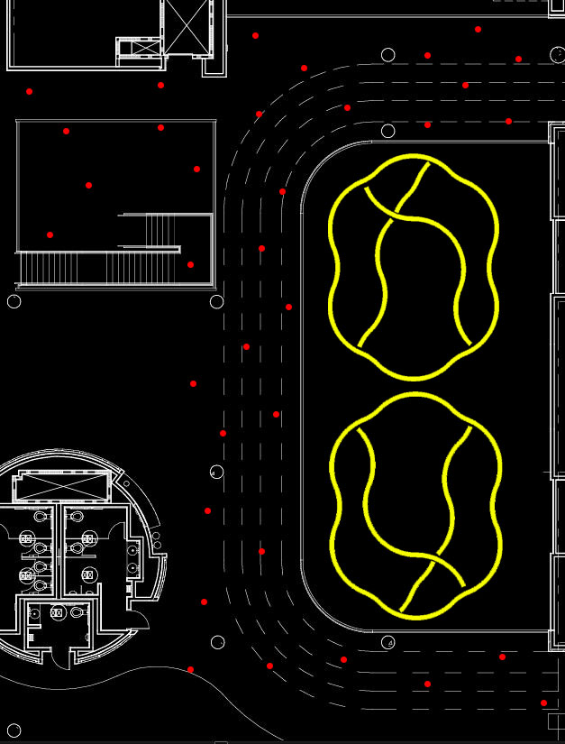

Introduction
Entrance
Lobby
Daylighting Analysis
Photovoltaic Analysis
Structural Analysis
Conclusion
Space | Target E_{avg} | Target E_{avg}:E_{min}
Lobby | 50 lux | 3
Transition | 45 lux | 2
Exercise Area | 150 lux | 3
Running Track | 150 lux | 3
Space | ASHRAE 90.1 2010 Allowable Watts | Title 24 Allowable Watts
Lobby | 10,504 | 9,236
N

Slide 26
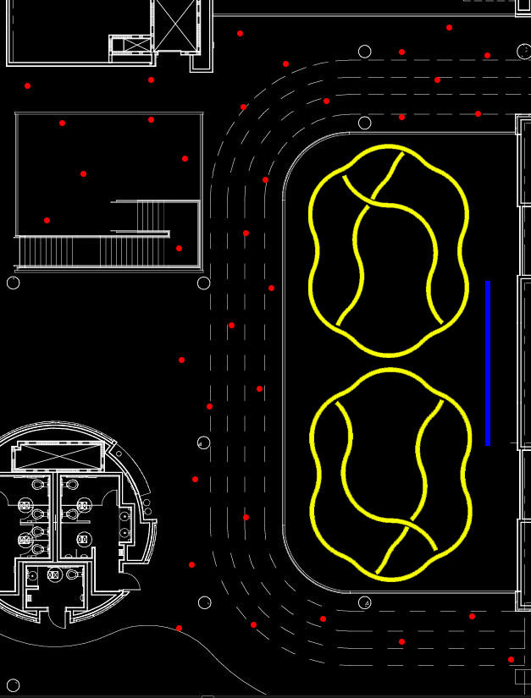
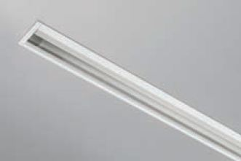
Introduction
Entrance
Lobby
Daylighting Analysis
Photovoltaic Analysis
Structural Analysis
Conclusion
Space | Target E_{avg} | Target E_{avg}:E_{min}
Lobby | 50 lux | 3
Transition | 45 lux | 2
Exercise Area | 150 lux | 3
Running Track | 150 lux | 3
Space | ASHRAE 90.1 2010 Allowable Watts | Title 24 Allowable Watts
Lobby | 10,504 | 9,236
N

Slide 27
Introduction
Entrance
Lobby
Daylighting Analysis
Photovoltaic Analysis
Structural Analysis
Conclusion
Space | Target E_{avg} | Target E_{avg}:E_{min} | Design E_{avg} | Design E_{avg}:E_{min}
Lobby | 50 lux | 3 | 46.06 lux | 1.98
Circulation | 45 lux | 2 | 91.25 lux | 2.78
Stairs | 45 lux | 2 | 52.10 lux | 1.85
Exercise Area | 150 lux | 3 | 164.09 lux | 2.25
Running Track | 150 lux | 3 | 152.76 lux | 3.06
Space | ASHRAE 90.1 2010 Allowable Watts | Title 24 Allowable Watts | Design Watts
Lobby | 10,504 | 9,236 | 4702
N

Slide 28
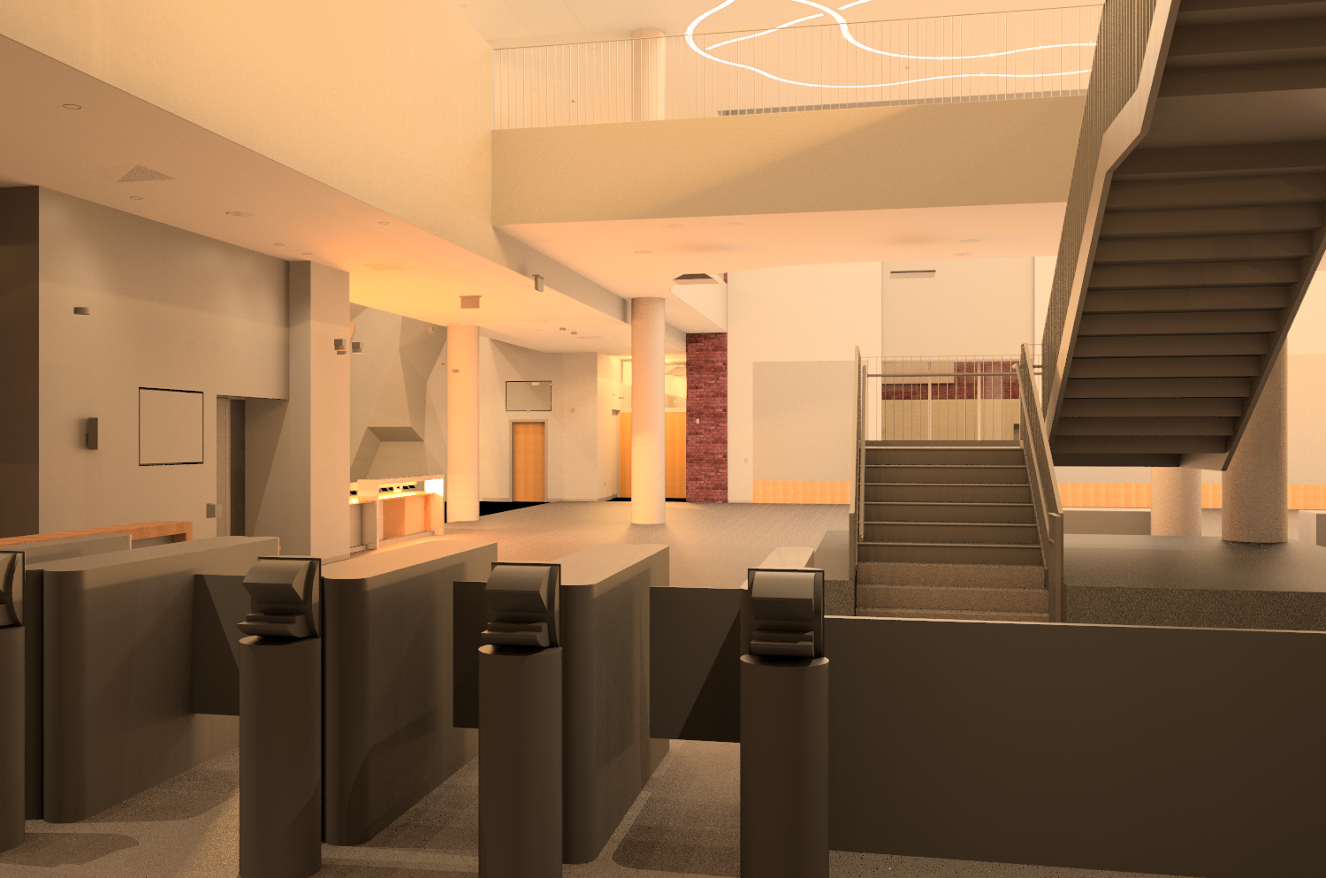
Introduction
Entrance
Lobby
Daylighting Analysis
Photovoltaic Analysis
Structural Analysis
Conclusion

Slide 29
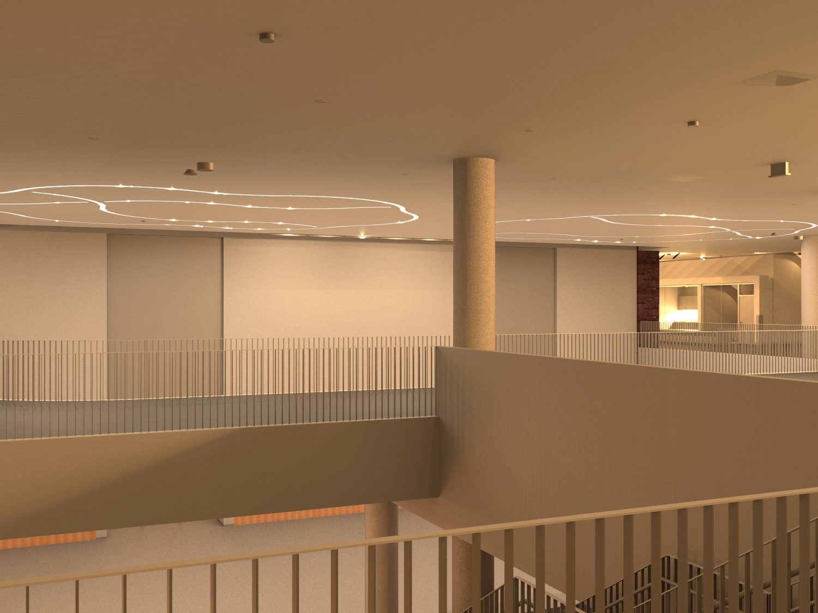
Introduction
Entrance
Lobby
Daylighting Analysis
Photovoltaic Analysis
Structural Analysis
Conclusion

Slide 30
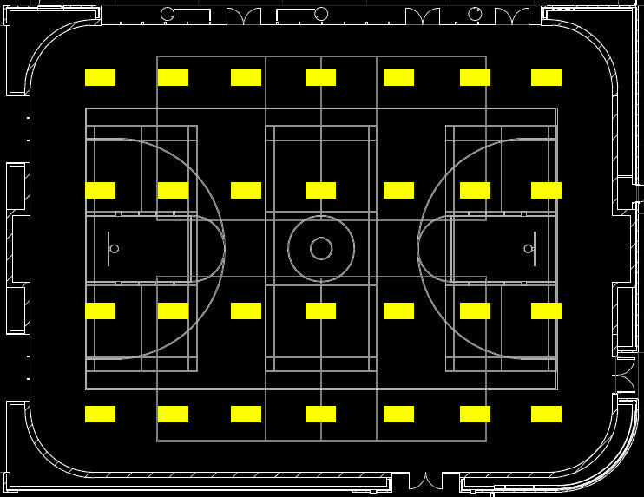
Introduction
Entrance
Lobby
Daylighting Analysis
Photovoltaic Analysis
Structural Analysis
Conclusion
Space | Target E_{avg} | Target E_{avg}:E_{min} | Design E_{avg} | Design E_{avg}:E_{min}
Gymnasium | 500 lux | 4 | 449.03 lux | 1.89
Space | ASHRAE 90.1 2010 Allowable Watts | Title 24 Allowable Watts | Design Watts
Gymnasium | 8148 | 8230 | 5208
N

Slide 31
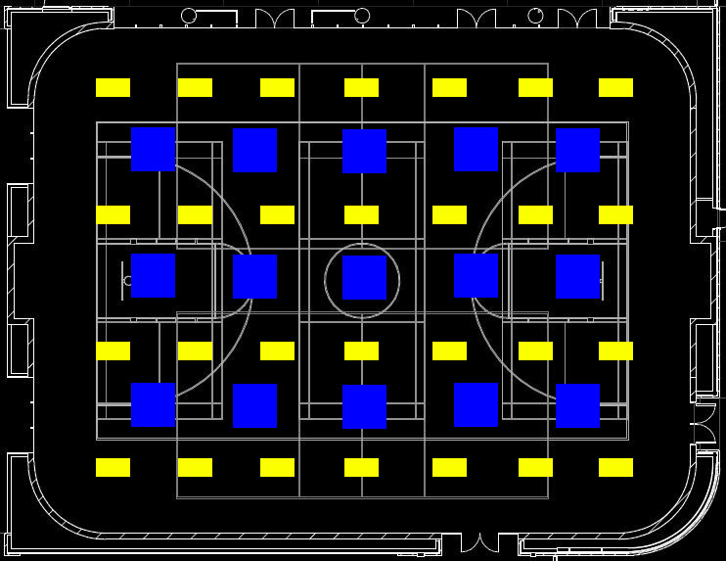
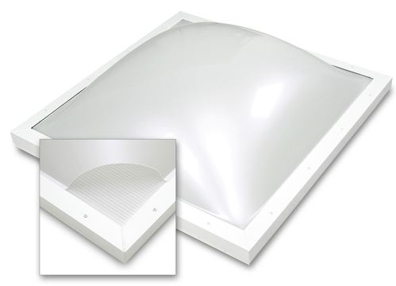
Introduction
Entrance
Lobby
Daylighting Analysis
Photovoltaic Analysis
Structural Analysis
Conclusion
Space | Target E_{avg} | Target E_{avg}:E_{min} | Design E_{avg} | Design E_{avg}:E_{min}
Gymnasium | 500 lux | 4 | 449.03 lux | 1.89
Space | ASHRAE 90.1 2010 Allowable Watts | Title 24 Allowable Watts | Design Watts
Gymnasium | 8148 | 8230 | 5208
Unit | Visible Light Transmission | U-Factor | Solar Heat Gain Coefficient
EcoSky 3 | 62% | 0.82 | 0.47
N

Slide 32

Introduction
Entrance
Lobby
Daylighting Analysis
Photovoltaic Analysis
Structural Analysis
Conclusion
Space | Target E_{avg} | Target E_{avg}:E_{min} | Design E_{avg} | Design E_{avg}:E_{min}
Gymnasium | 500 lux | 4 | 449.03 lux | 1.89
Space | ASHRAE 90.1 2010 Allowable Watts | Title 24 Allowable Watts | Design Watts
Gymnasium | 8148 | 8230 | 5208
Unit | Visible Light Transmission | U-Factor | Solar Heat Gain Coefficient
EcoSky 3 | 62% | 0.82 | 0.47
N

Slide 33
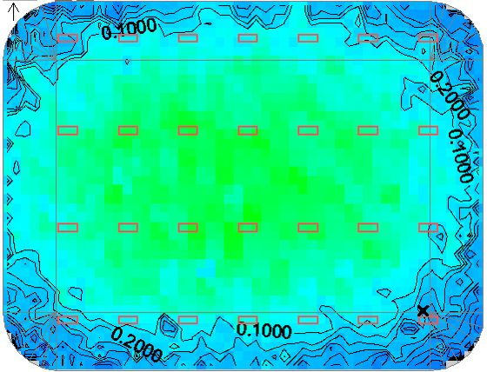
Introduction
Entrance
Lobby
Daylighting Analysis
Photovoltaic Analysis
Structural Analysis
Conclusion
Critical Point Selection

Slide 34
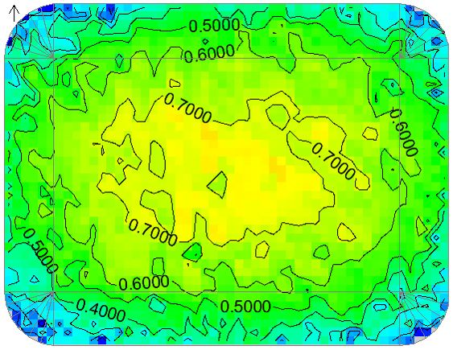
Introduction
Entrance
Lobby
Daylighting Analysis
Photovoltaic Analysis
Structural Analysis
Conclusion
Critical Point Selection
Daylight Autonomy at 500 lux
Points above 50%: 67.95%

Slide 35
Introduction
Entrance
Lobby
Daylighting Analysis
Photovoltaic Analysis
Structural Analysis
Conclusion
 | Jan-Mar | April-June | July-Sep | Nov-Dec | Total
Base | 6,854 | 6,984 | 7,140 | 6,447 | 27,425
Optimal | 5,404 | 4,094 | 4,188 | 5,088 | 18,774
Algorithm | 5,321 | 4,139 | 4,245 | 5,021 | 18,726
Difference | 83 | -44 | -57 | 66 | 49
Savings | 1,533 | 2,845 | 2,896 | 1,426 | 8,700
Daylight Autonomy at 500 lux
Points above 50%: 67.95%

Slide 36
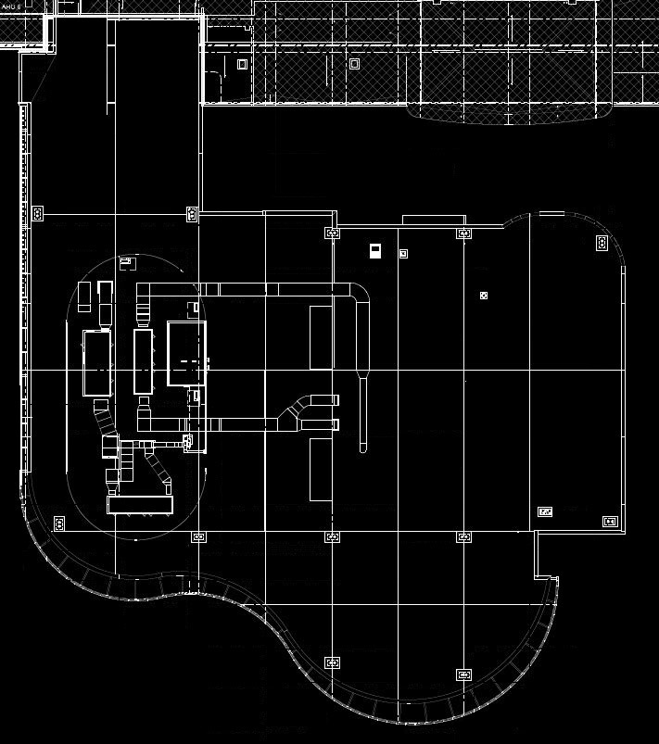
Introduction
Entrance
Lobby
Daylighting Analysis
Photovoltaic Analysis
Structural Analysis
Conclusion

Slide 37
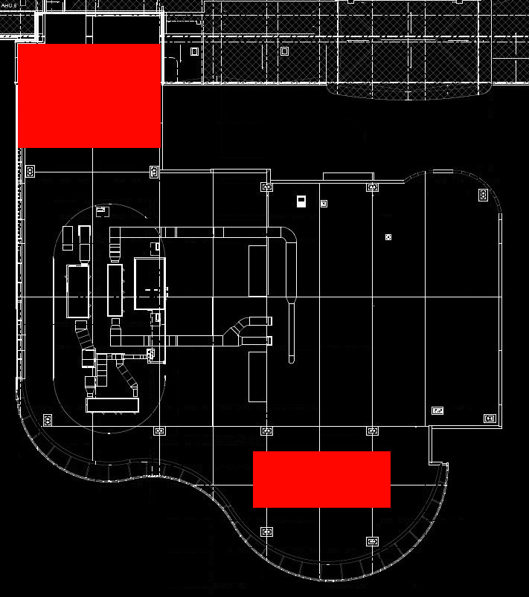
Introduction
Entrance
Lobby
Daylighting Analysis
Photovoltaic Analysis
Structural Analysis
Conclusion

Slide 38
Introduction
Entrance
Lobby
Daylighting Analysis
Photovoltaic Analysis
Structural Analysis
Conclusion
Solar Ray
Panel
Panel
3.82’
Section | Number of Rows | Solar Panel Width | Roof Area Width | Watts/SF | Total Capacity (kW)
North | 15 | 2.21 ft | 72 | 9 | 21.48
South | 10 | 2.21 ft | 75 | 9 | 14.92
Total | N/A | N/A | N/A | N/A | 36.40

Slide 39
Introduction
Entrance
Lobby
Daylighting Analysis
Photovoltaic Analysis
Structural Analysis
Conclusion
Analysis Assumptions
Building Load: Operates at half connected load during operating hours
Panel Output Depreciation: 0.5% per year, compounded
Cost of Electricity: $0.12/kWh
Taxes: Exempt from property and income taxes
Incentives: Production based incentive of $0.139/kWh for first 5 years
Analysis Results
Initial Cost | $104,996.56
Annual Energy | 58,398 kWh
Levelized Cost of Energy | $0.1163/kWh
Payback Period | 4.93 years

Slide 40
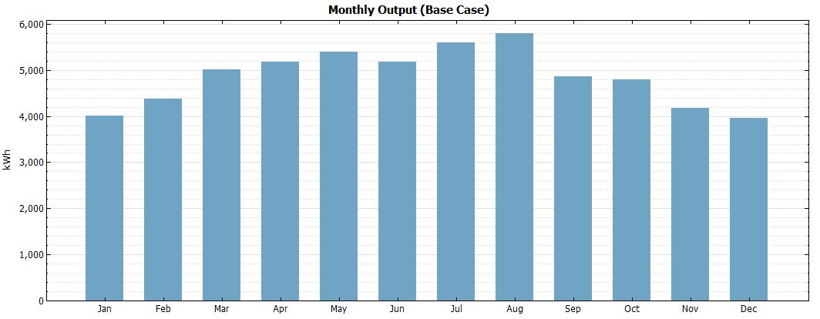
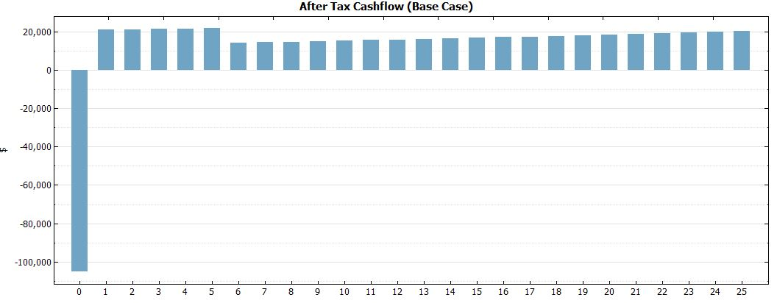
Introduction
Entrance
Lobby
Daylighting Analysis
Photovoltaic Analysis
Structural Analysis
Conclusion
Monthly Output (kWh)
25 Year Cash Flow

Slide 41
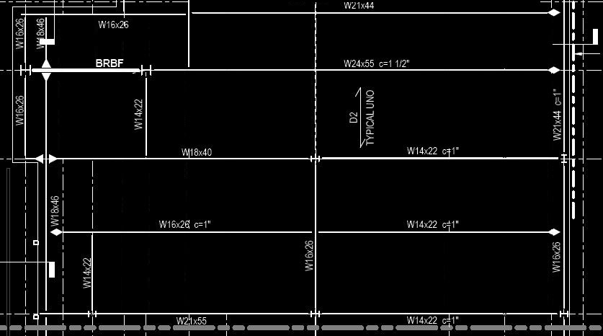
Introduction
Entrance
Lobby
Daylighting Analysis
Photovoltaic Analysis
Structural Analysis
Conclusion

Slide 42
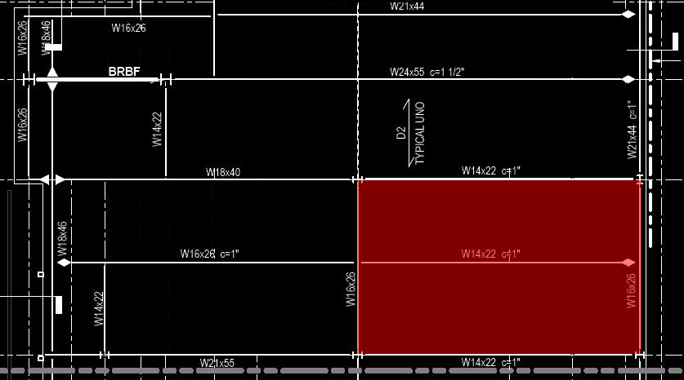
Introduction
Entrance
Lobby
Daylighting Analysis
Photovoltaic Analysis
Structural Analysis
Conclusion

Slide 43
Introduction
Entrance
Lobby
Daylighting Analysis
Photovoltaic Analysis
Structural Analysis
Conclusion
Dead Loads
Roof Deck: 2 psf
Insulation: 1 psf
Misc. Dead Load: 10 psf
Member Self Weight: 5 psf
Solar Panels: 5 psf
Total: 23 psf
Dead Loads
Roof Live Load: 20 psf
1.2*(23psf) + 1.6*(20psf) = 59.6 psf
B
D
E
O
A
C

Slide 44
Introduction
Entrance
Lobby
Daylighting Analysis
Photovoltaic Analysis
Structural Analysis
Conclusion
Beam | Tributary Width (ft) | Uniform Load (plf) | Span (ft) | Reaction At Supports (kips) | Maximum Moment (kip*ft)
A | 10.5 | 625.8 | 33.5 | 10.48 | 87.77
B | 10.875 | 648.15 | 33.5 | 10.86 | 90.95
C | 10.75 | 640.7 | 33.5 | 10.73 | 89.86
O | 10.5 | 625.8 | 36.25 | 11.34 | N/A
B
D
E
O
A
C

Slide 45
Introduction
Entrance
Lobby
Daylighting Analysis
Photovoltaic Analysis
Structural Analysis
Conclusion
Beam | Point Load (kips) | North Reaction (kips) | South Reaction (kips) | Maximum Moment (kip*ft)
D | 21.82 | 11.43 | 10.39 | 114.3
E | 10.48 | 5.49 | 4.99 | 54.9
B
D
E
O
A
C

Slide 46
Introduction
Entrance
Lobby
Daylighting Analysis
Photovoltaic Analysis
Structural Analysis
Conclusion
Beam | Size | Maximum Moment (kip*ft) | Φ_{b}M_{px} (kip*ft)
A | W 14X22 | 87.77 | 125
B | W 14X22 | 90.95 | 125
C | W 14X22 | 89.86 | 125
D | W 16x26 | 114.3 | 166
E | W 16x26 | 54.9 | 166
B
D
E
O
A
C

Slide 47
Introduction
Entrance
Lobby
Daylighting Analysis
Photovoltaic Analysis
Structural Analysis
Conclusion
Conclusions
Lighting: Provided a lighting design reflecting the use of the building
Daylighting: Provided a daylighting system that provides energy savings in the gymnasium
Photovoltaic Analysis: Photovoltaic array provides energy and reduces the cost of the building
Structural Analysis: The structural members do not need to be redesigned because of the photovoltaic array
Acknowledgements
Dr. Houser
Dr. Mistrick
Professor Parfitt
Professor Holland
Cannon Design
Family and Friends

Slide 48
Questions?

Slide 49
References
maps.google.com
http://campusmap.ucr.edu/imap/index.html
http://runningtowardsomethingnew.com/tag/treadmill-running/
http://www.elyevergreencottage.com/
http://www.mccoysauna.com/
http://health.howstuffworks.com/wellness/men/health-tips/weight-lifting-and-weight-control.htm
http://upload.wikimedia.org/wikipedia/commons/7/7a/Playing_volleyball_in_Guantanamo_Gym.jpg
http://www.eulesstx.gov/images/pacs/athletics/MensBasketball1.jpg
http://relaxationblog.relaxing-tranquility-moments.com/wp-content/uploads/2010/09/meditation_techniques.jpg
http://www.makemedicinebetter.org/wp-content/uploads/2011/10/Yoga-Class.jpg

